Slide 1

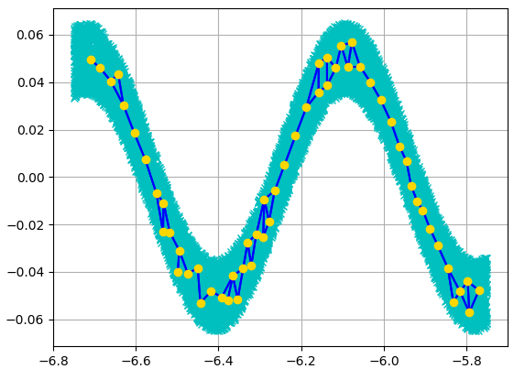
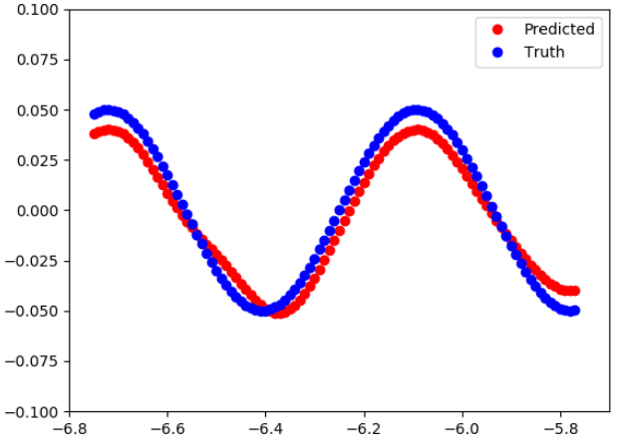
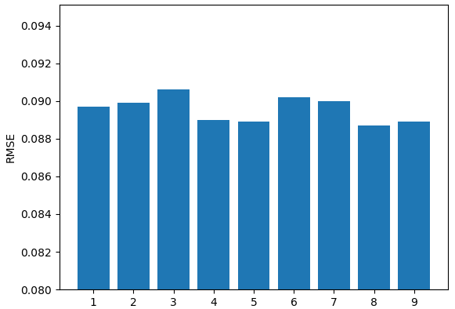
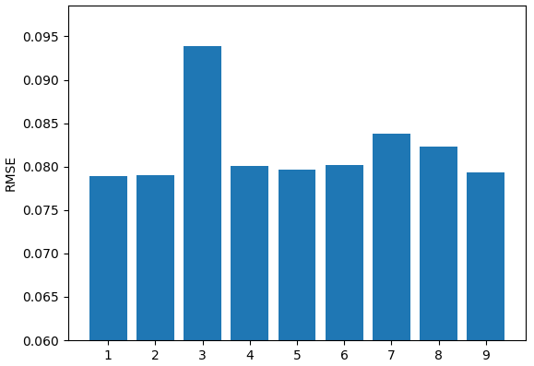
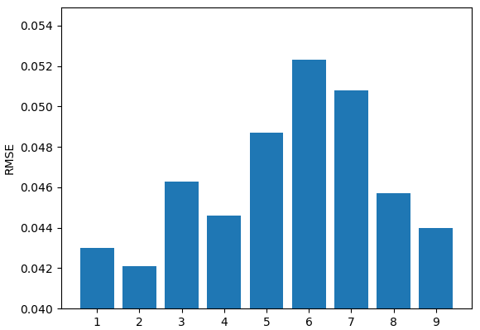
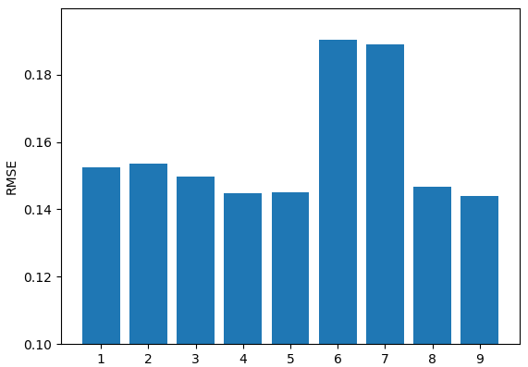
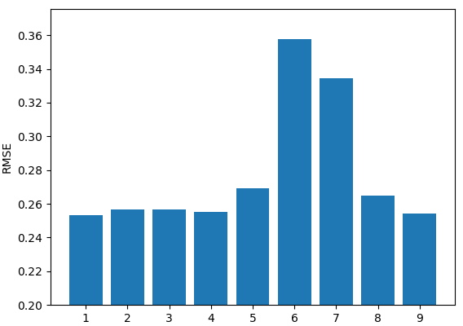



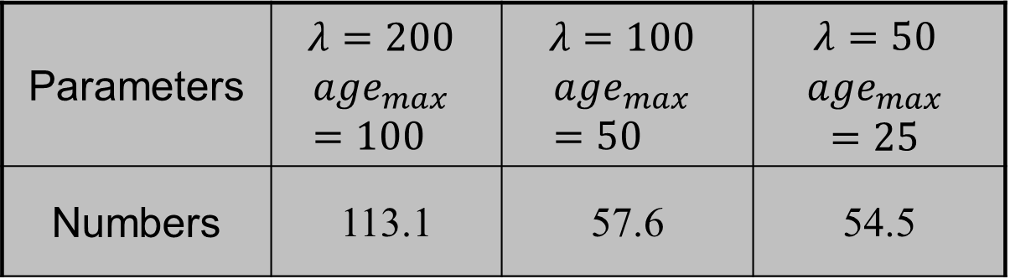



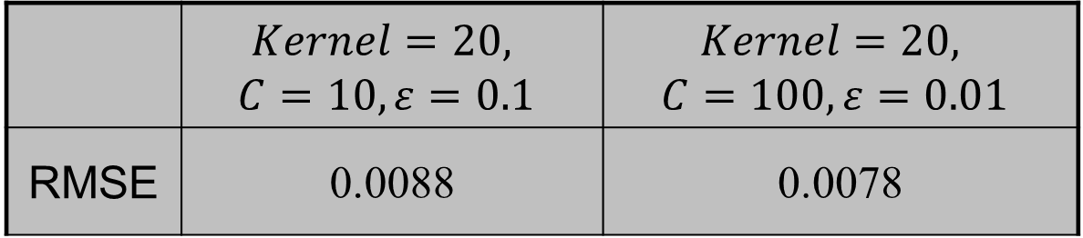
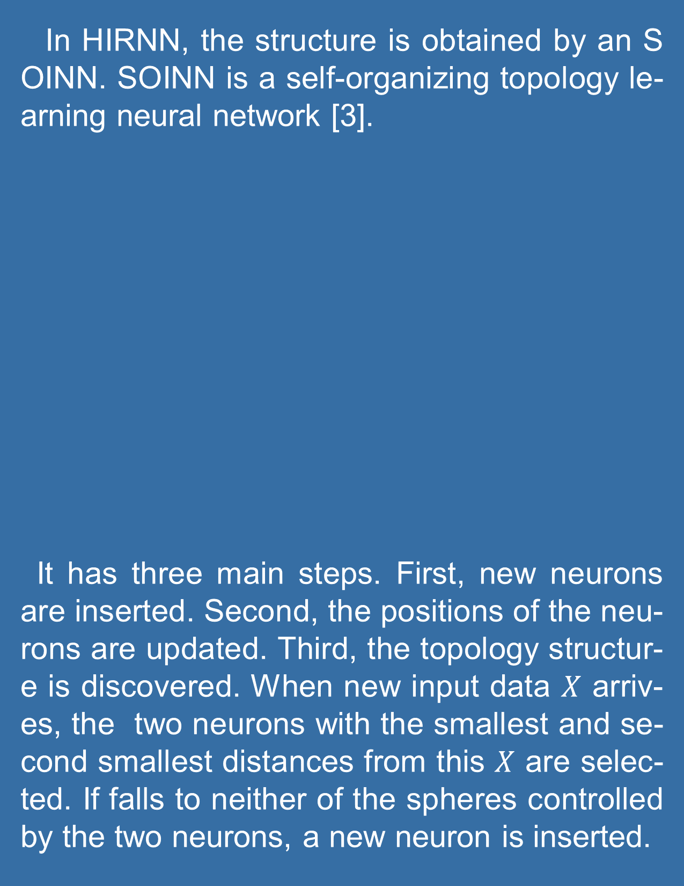

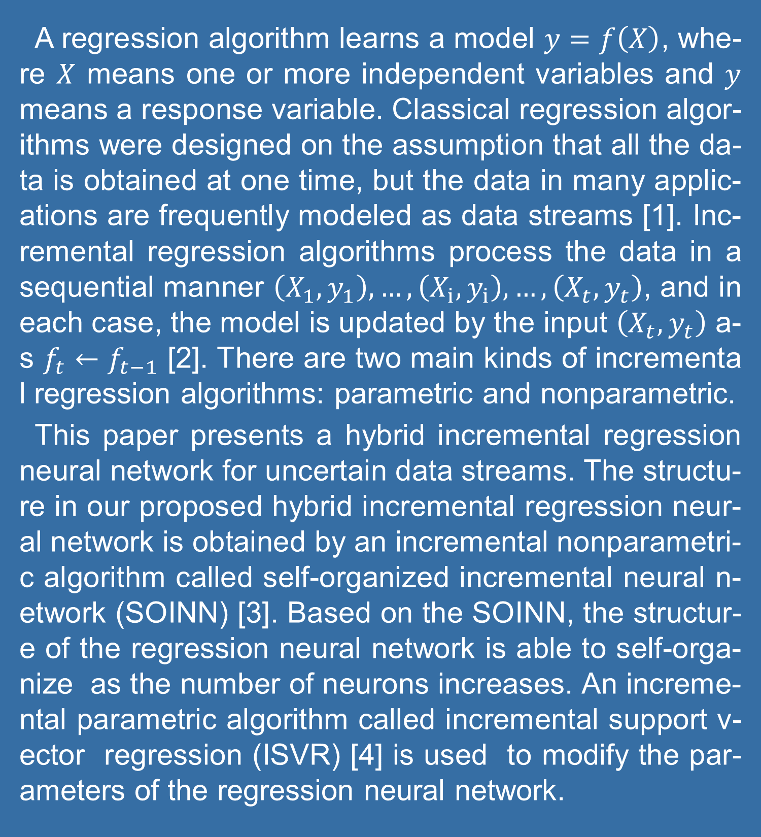

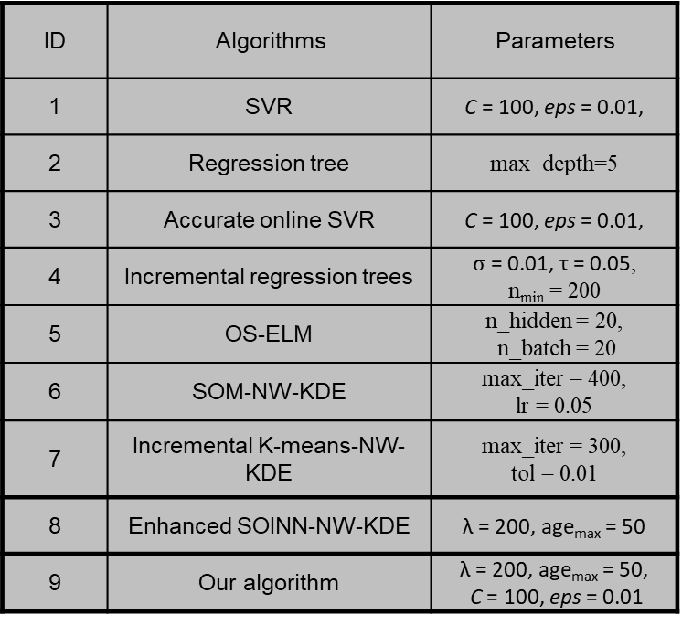

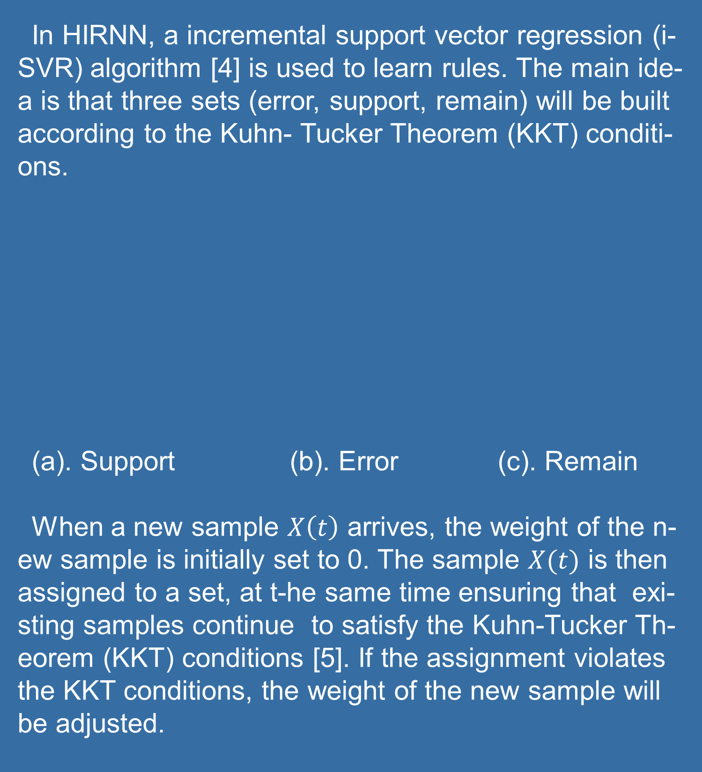
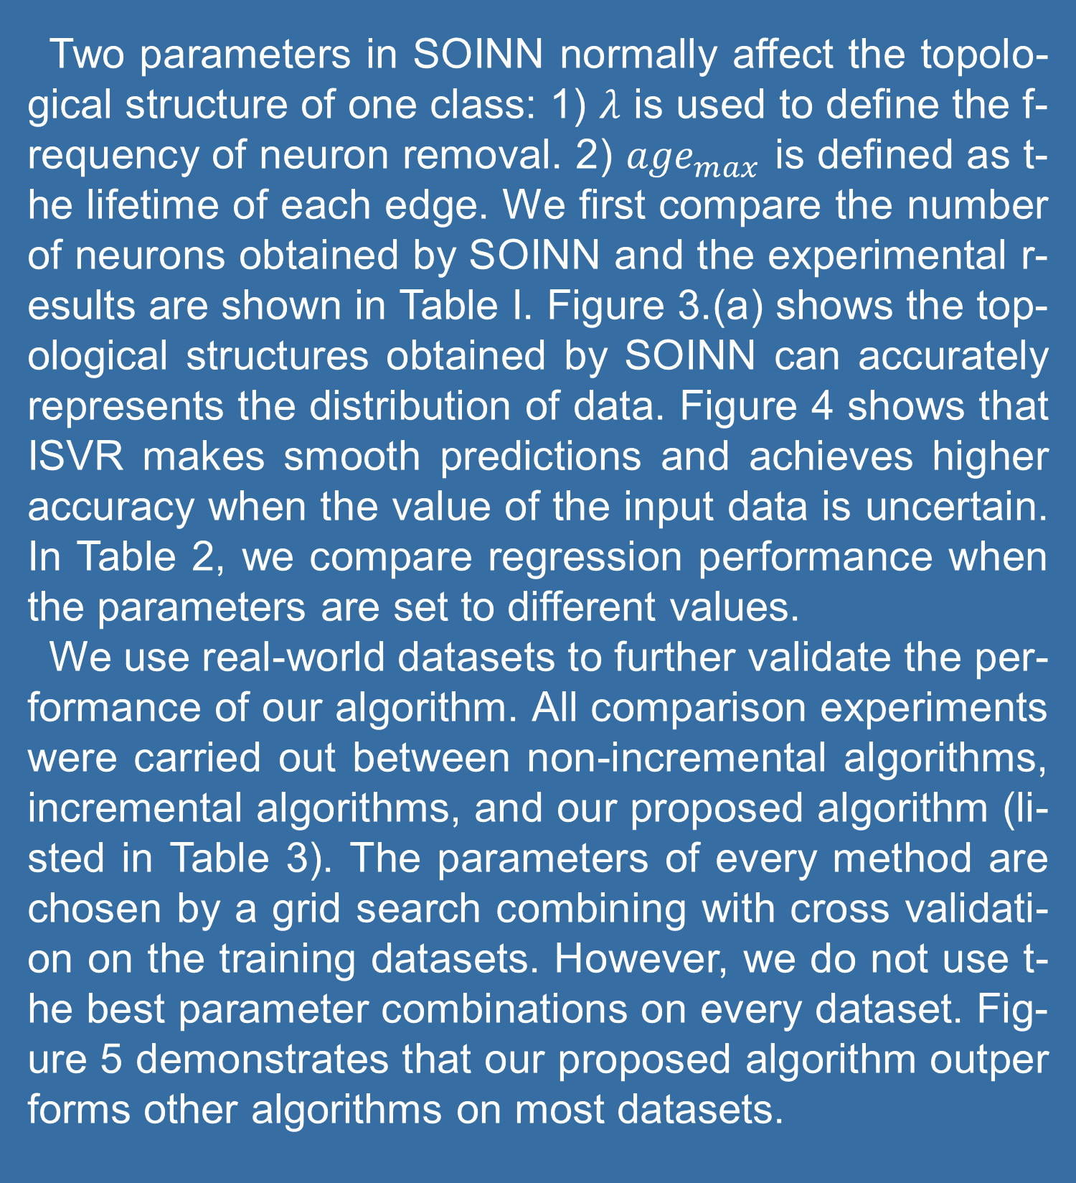


A Hybrid Incremental Regression Neural Network for Uncertain Data Streams
Hang Yu
Centre for Artificial Intelligence, Faculty of Engineering and Information Technology, University of Technology Sydney
ABSTRACT
INTRODUCTION
PRELIMINARIES
STRUCTURE OF HIRNN
LEARNING RULES OF HIRNN
The design of classical regression al-gorithms was based on the assumpt-ion that all the required data is obtai-ned at one time. With the emergence of big data, however, data is increas-ingly displayed in sequence form, su-ch as in data streams, and can be r-ead only once in a specific order. M-any incremental regression algorith-ms which process data in a sequenti-al manner have been proposed, but the accuracy of these algorithms det-eriorates when the value of the data is uncertain. This paper proposes a hybrid incremental regression neural network based on self-organizing in-cremental neural network and incre-mental fuzzy support vector regressi-on. In our proposed network, the ne-urons of the regression neural netw-ork are obtained by an self-organize-d incremental neural network (SOIN-N). This enables the regression neur-al network structure to self-organize as the number of neurons increases. An incremental support vector regre-ssion (ISVR) algorithm is then used to modify the parameters of the regr-ession neural network. By combining the improved SOINN and ISVR algo-rithms, our proposed hybrid increme-ntal regression neural net-work is ab-le to learn an accurate regression m-odel from uncertain data streams.
A regression algorithm learns a model $y=f\left(X\right)$, whe-re $X$ means one or more independent variables and $y$ means a response variable. Classical regression algor-ithms were designed on the assumption that all the da-ta is obtained at one time, but the data in many applic-ations are frequently modeled as data streams [1]. Inc-remental regression algorithms process the data in a sequential manner $\left(X_{1},y_{1}\right), …, \left(X_{i},y_{i}\right), …,\left(X_{t},y_{t}\right)$, and in each case, the model is updated by the input $\left(X_{t},y_{t}\right)$ a-s $f_{t}←f_{t−1}$ [2]. There are two main kinds of incremental regression algorithms: parametric and nonparametric.
This paper presents a hybrid incremental regression neural network for uncertain data streams. The structu-re in our proposed hybrid incremental regression neur-al network is obtained by an incremental nonparametri-c algorithm called self-organized incremental neural n-etwork (SOINN) [3]. Based on the SOINN, the structur-e of the regression neural network is able to self-orga-nize as the number of neurons increases. An increme-ntal parametric algorithm called incremental support v-ector regression (ISVR) [4] is used to modify the par-ameters of the regression neural network.
Our proposed hybrid incremental regression neural n-etwork (HIRNN) is a single layered feedforward neural network.
The left neurons are in the input layer, but the true la-yer is the hidden layer. The neurons in the hidden lay-er commonly have a non-linear function $f\left(X(t)\right)$. The i-nput data $X\left(t\right)∈R^{d}$ is connected to every neuron in th-e hidden layer through the edges $θ_{i}$. The neuron in the output layer is computed by $\sum_{i}^{N}{θ_{i}\left(t\right)f(X\left(t\right),X_{i})}$.
In HIRNN, the structure is obtained by an SOINN. SOINN is a self-organizing topology le-arning neural network [3].
It has three main steps. First, new neurons are inserted. Second, the positions of the neu-rons are updated. Third, the topology structur-e is discovered. When new input data $X$ arriv-es, the two neurons with the smallest and se-cond smallest distances from this $X$ are selec-ted. If falls to neither of the spheres controlled by the two neurons, a new neuron is inserted.
In HIRNN, a incremental support vector regression (i-SVR) algorithm [4] is used to learn rules. The main ide-a is that three sets (error, support, remain) will be built according to the Kuhn- Tucker Theorem (KKT) conditi-ons.
(a). Support (b). Error (c). Remain
When a new sample $X\left(t\right)$ arrives, the weight of the n-ew sample is initially set to 0. The sample $X(t)$ is then assigned to a set, at t-he same time ensuring that exi-sting samples continue to satisfy the Kuhn-Tucker Th-eorem (KKT) conditions [5]. If the assignment violates the KKT conditions, the weight of the new sample will be adjusted.
Input Layer
Hidden Layer
Output Layer
S3
T2
$$f(X(t),W_{1})$$
T3
S2
S1
$$f(X(t),W_{2})$$
$$θ_{1}$$
T1
$$X(t)$$
…
$$θ_{2}$$
$$y(t)$$
$$f(X(t),W_{i})$$
$$θ_{i}$$
$$f(X(t),W_{N})$$
$$θ_{N}$$
RESULTS
CONCLUSIONS
Two parameters in SOINN normally affect the topolo-gical structure of one class: 1) $λ$ is used to define the f-requency of neuron removal. 2) ${age}_{max}$ is defined as t-he lifetime of each edge. We first compare the number of neurons obtained by SOINN and the experimental r-esults are shown in Table I. Figure 3.(a) shows the top-ological structures obtained by SOINN can accurately represents the distribution of data. Figure 4 shows that ISVR makes smooth predictions and achieves higher accuracy when the value of the input data is uncertain. In Table 2, we compare regression performance when the parameters are set to different values.
We use real-world datasets to further validate the per-formance of our algorithm. All comparison experiments were carried out between non-incremental algorithms, incremental algorithms, and our proposed algorithm (li-sted in Table 3). The parameters of every method are chosen by a grid search combining with cross validati-on on the training datasets. However, we do not use t-he best parameter combinations on every dataset. Fig-ure 5 demonstrates that our proposed algorithm outperforms other algorithms on most datasets.
In this paper, we have focused on the problem of incr-emental regression learning and proposed a hybrid in-cremental regression neural network. The neurons of the regression neural network in our proposed algorith-m are obtained by an SOINN algorithm. An ISVR is us-ed to modify the parameters of the regression neural network. Through the combination of improved SOINN and ISVR, our proposed incremental regression algori-thm makes accurate and smooth predictions from data streams.
(a). Abalone
(b). Parkinsons
(a). SOINN
(b). ISVR
Figure 1. The Results of Artificial Datasets.
(c). CPU
(d). California Housing
(e). Protein
REFERENCES
Parameters | $$λ=200$$ $${age}_{max}=100$$ | $$λ=100$$ $${age}_{max}=50$$ | $$λ=50$$ $${age}_{max}$$ $$=25$$
Numbers | 113.1 | 57.6 | 54.5
Figure 2. The Results of Real-World Datasets.
CONTACT
ID | Algorithms | Parameters
1 | SVR | C = 100, eps = 0.01,
2 | Regression tree | max_depth=5
3 | Accurate online SVR | C = 100, eps = 0.01,
4 | Incremental regression trees | $σ$= 0.01, τ = 0.05, n_{min} = 200
5 | OS-ELM | n_hidden = 20, n_batch = 20
6 | SOM-NW-KDE | max_iter = 400, lr = 0.05
7 | Incremental K-means-NW-KDE | max_iter = 300, tol = 0.01
8 | Enhanced SOINN-NW-KDE | λ = 200, age_{max} = 50
9 | Our algorithm | λ = 200, age_{max} = 50, C = 100, eps = 0.01
Dataset | Size | Attr (s)
Abalone | 4177 | 8
Parkinsons | 5875 | 21
CPU | 8192 | 19
Calisfornia Housing | 20640 | 8
Protein | 45730 | 9
H. L. Nguyen, Y. K. Woon, and W. K. Ng, “A survey on data stream clustering and classification,” Knowl. Inf. Syst., vol. 45, no. 3, pp. 535–569, 2015.
V. Losing, B. Hammer, and H. Wersing, “Incremental on-line learning: A review and comparison of state of the art algorithms,” Neurocomputing, vol. 275, pp. 1261–1274, Jan. 2018.
S. Furao and O. Hasegawa, “An incremental network for on-line unsupervised classification and topology learning,” Neural Networks, vol. 19, no. 1, pp. 90–106, 2006.
J. Ma, J. Theiler, and S. Perkins, “Accurate on-line support vector regression,” Neural Comput., vol. 15, no. 11, pp. 2683–2703, Nov. 2003.
K.William. Traces and Emergence of Nonlinear Programming, Birkhäuser Basel Press, Berlin, Ger-many 2014.
Hang Yu
University of Technology Sydney
Email: Hang.Yu@student.uts.edu.au
Table 1. The Average Number of Neurons.
 | $$Kernel=20,$$ $$C=10, ε=0.1$$ | $$Kernel=20,$$ $$C=100, ε=0.01$$
RMSE | 0.0088 | 0.0078
Table 2. RMSE
Table 3. Algorithms.
Table 4. Datasets

